Slide 1
Register Reference Instructions

Slide 2
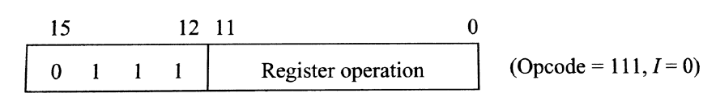
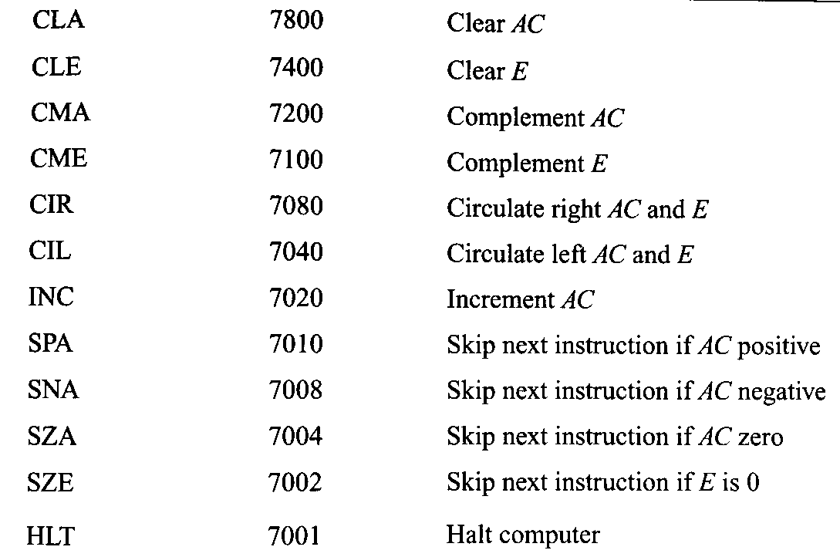
Register Reference Instructions
Register-reference instructions are mainly used in order to perform operations on registers.

Slide 3
Register Reference Instructons
CLA (Clear AC) : rB₁₁ : AC->0
CLE (Clear E) : rB₁₀ : E->0
CMA (Complement AC) : rB₉ : AC->AC’
CME (Complement E) : rB₈ : E->E’
CIR (Circulate Right) : rB₇ : AC->shr AC, E->AC(0), AC(15) ->E
CIR (Circulate Left) : rB₆ : AC->shl AC, E->AC(15), AC(0) ->E
INC (Increment AC) : rB₅ : AC->AC+1
SPA (Skip next instruction if AC positive) : rB₄ : If(AC(15)=0) then PC->PC+1
SNA(Skip next instruction if AC negative) : rB₃ : If(AC(15)=1) then PC->PC+1
SZA (Skip next instruction if AC zero) : rB₂ : If(AC=0) then PC->PC+1
SZE (Skip next instruction if E zero) : rB₁ : If(E=0) then PC->PC+1
HLT (Halt computer) : rB₀ : S->0 (Start–stop flip flop whenever this is executed then the entire program is halted).

